Slide 1



深度學習 Deep Learning
Project Introduction
Instructor: 林英嘉 (Ying-Jia Lin)
2025/04/07
Course GitHub
Slido # DL_0324

Slide 2
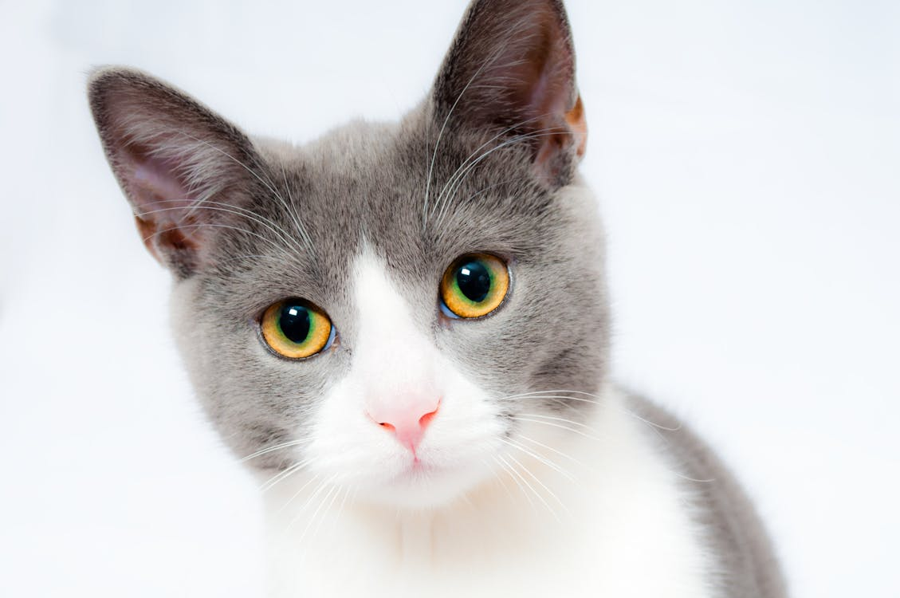


如何評估模型效能？
Class
Pred
Gold
Cat
✅
Model
Dog
Fox
…
我們不能只憑一筆資料就說模型很棒…
Cat
Model
Dog
✅
Fox
…

Slide 3
自動化評估
「評估」的意義：量化模型的表現
(假設用二分類任務)
 | Pred | Gold
1 | 1 | 0
2 | 1 | 1
3 | 1 | 1
4 | 1 | 1
Image
Image
Image
Image
🖥️
資料
正確率：0.75
真正答對的數量 /
總預測的數量

Slide 4
評估方式 (計算模型有多高分的方式)
不同任務有不同的評估方式
Automatic Evaluation
(自動化評估)
Human Evaluation
(人工評估)
類型
🖥️
🧑‍🏫
「生成」任務較為需要

Slide 5

What is Kaggle?
Kaggle is a platform that provides:
Real-word datasets for machine learning
Competitions with prizes (sometimes with money)
Discussion forum with a lots of code examples

Slide 6
Kaggle submission types
Traditional competitions
Upload submission file (e.g., *.csv)
Code / Notebook competitions
Upload code (e.g., *.ipynb)
本課程 projects 採用此方式

Slide 7
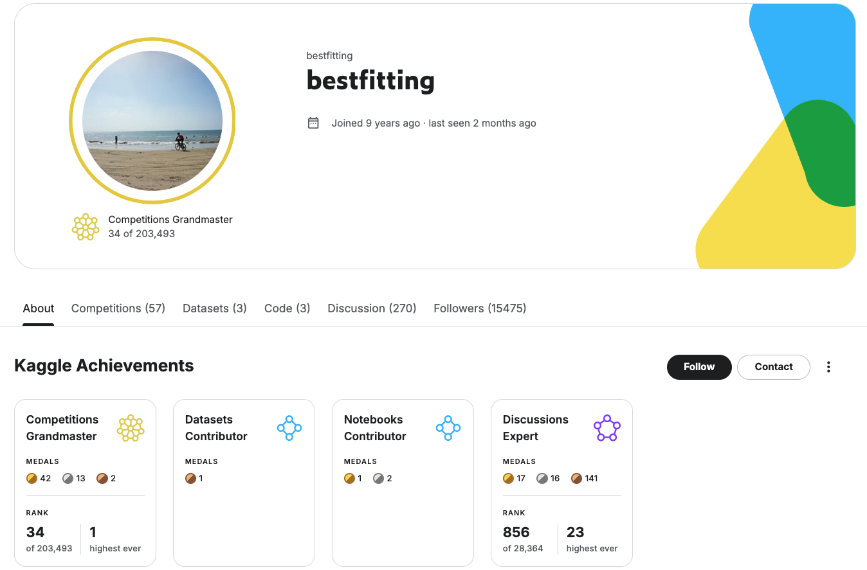
If you play Kaggle a lot …
Figure source: https://www.kaggle.com/bestfitting

Slide 8
Outline of tasks
Platform | Competition Name | Data Type | Task Type | Why special? (Difficulty)
Kaggle | Dog Breed Identification | Image | Image Classification | 120 classes
 | Plant Pathology 2020 - FGVC7 | Image | Image Classification | Class imbalance
 | Natural Language Processing with Disaster Tweets | Text | Text Classification | NLP
Notes:
Co

Slide 9
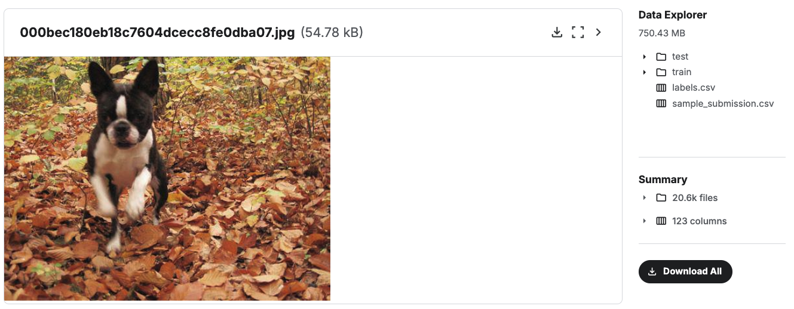
Dog Breed Identification
https://www.kaggle.com/competitions/dog-breed-identification/overview

Slide 10
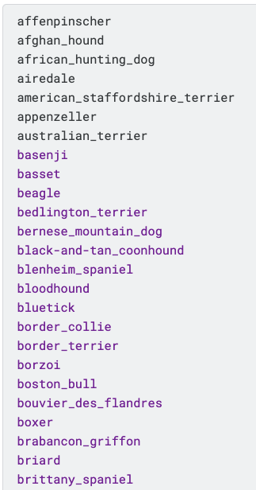
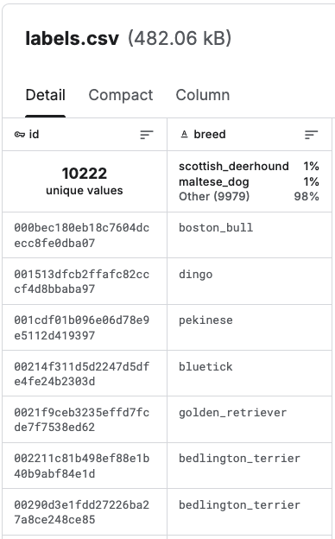
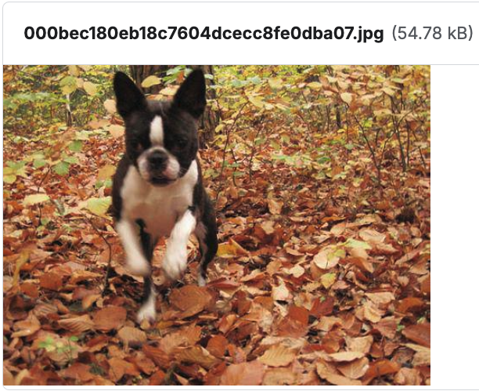
Dog Breed Identification
…

Slide 11
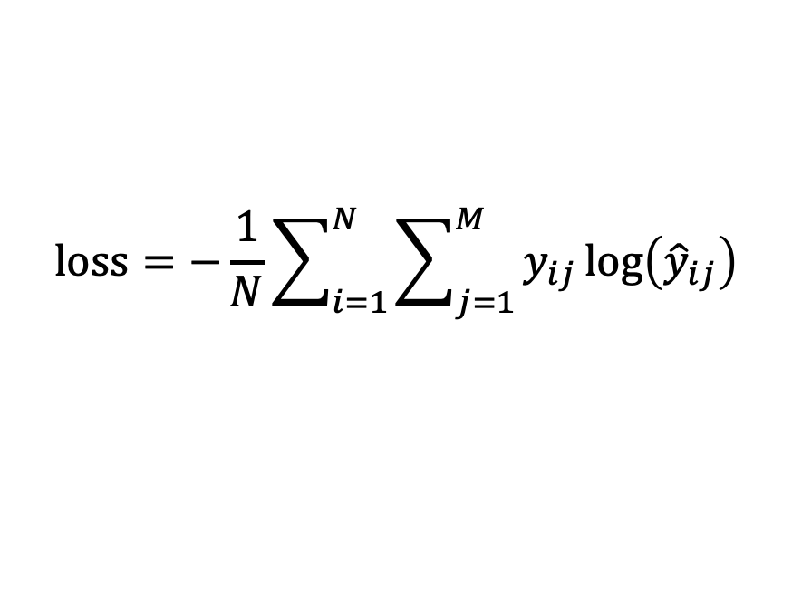
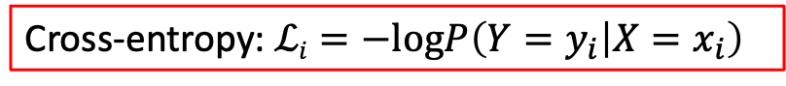
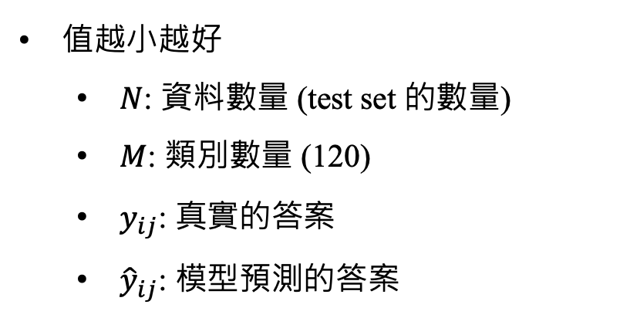
Dog Breed Identification (evaluation)
Multi Class Log Loss:
$$loss=−\frac{1}{N}\sum_{i=1}^{N}{\sum_{j=1}^{M}{y_{ij}}}log\left({\hat{y}}_{ij}\right)$$
值越小越好
$N$: 資料數量 (test set 的數量)
$M$: 類別數量 (120)
$y_{ij}$: 真實的答案
${\hat{y}}_{ij}$: 模型預測的答案
Cross-entropy: $ℒi=−logP\left(Y=y_{i} | X=x_{i}\right)$

Slide 12
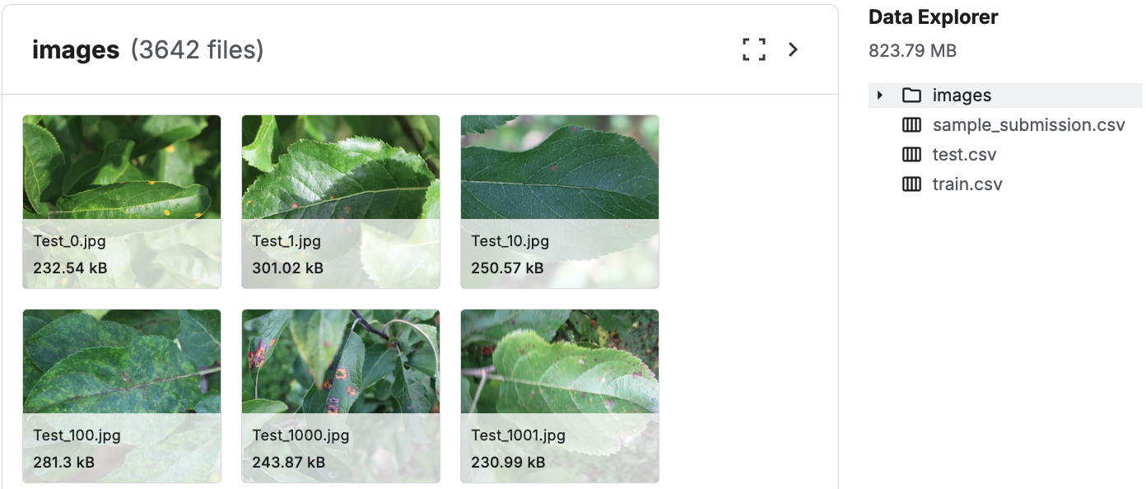
Plant Pathology 2020 - FGVC7
https://www.kaggle.com/competitions/plant-pathology-2020-fgvc7/data?select=images

Slide 13
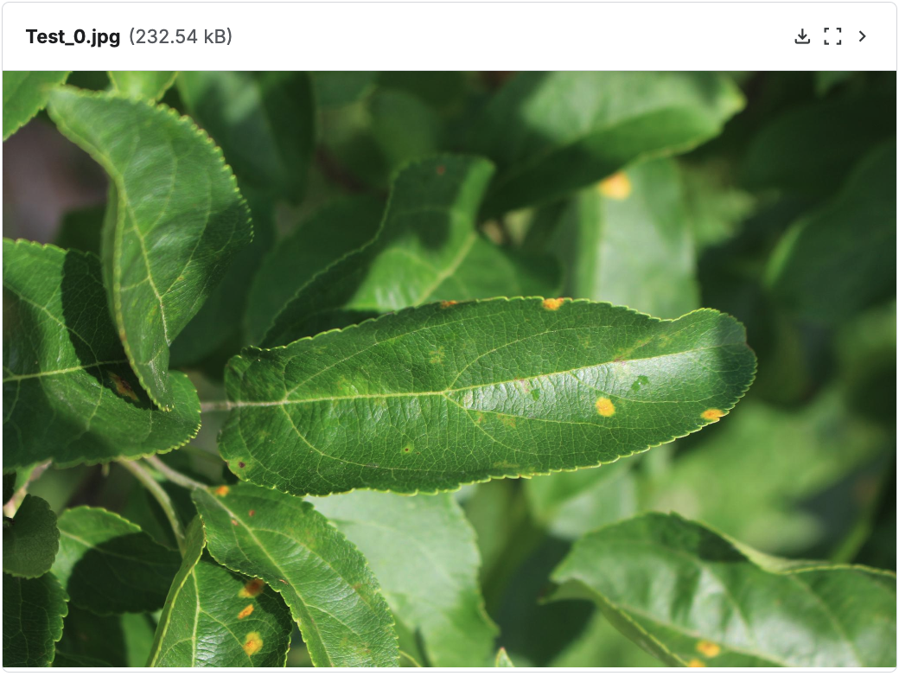
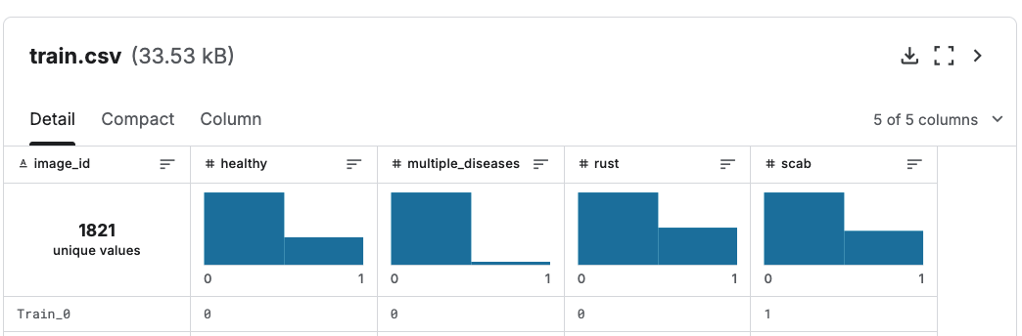
Plant Pathology 2020 - FGVC7
每張影像有4個類別
Healthy
Multiple diseases (多重疾病)
Rust (鏽病)
Scab (疥瘡病)

Slide 14
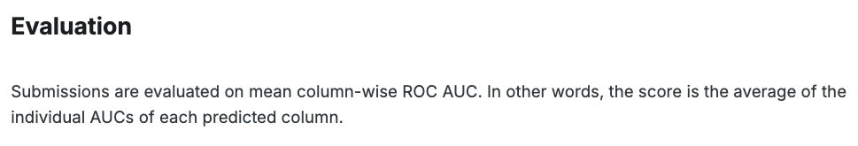
Plant Pathology 2020 - FGVC7 (Evaluation)
針對每個 label 的模型預測各算一次 AUC (Area Under the Curve) 之後，取平均

Slide 15
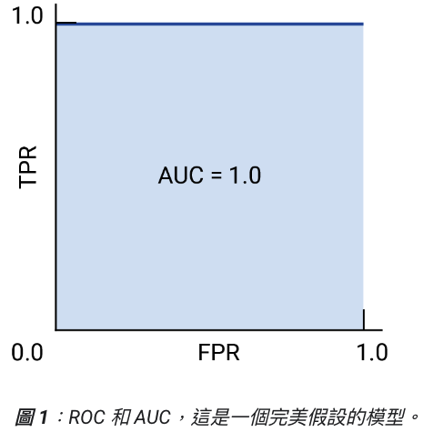
ROC Curve
(Useful!!) https://developers.google.com/machine-learning/crash-course/classification/roc-and-auc?hl=zh-tw
ROC curve: Receiver operating characteristic curve (接收者操作特徵曲線)
ROC curve 定義: 針對不同的模型分類門檻下的模型表現圖
X軸：False positive rate (FPR); Y軸：True positive rate (TPR)
AUC: ROC 的底面下面積 (越大越好)

Slide 16
模型分類門檻 (Threshold)
Rust
模型輸出
答案
Model
機率 = 0.55
1
我們應該設多少門檻？
threshold = 0.5 -> 模型預測為1，正確數量+1
threshold = 0.6 -> 模型預測為0，正確數量-1

Slide 17
TPR and FPR 範例
假設我們用模型對10個人做COVID-19檢測：
(COVID-19 代表 positive)
healthy
COVID-19
💪
💪
💪
🦠
🦠
💪
💪
🦠
🦠
🦠
模型預測為疾病的機率值
0
20
40
60
80
100

Slide 18
TPR and FPR 範例 (TPR)
假設我們用模型對10個人做COVID-19檢測：
(COVID-19 代表 positive)
True positive rate (TPR) = 4 / 5 = 0.8
healthy
COVID-19
❌
💪
💪
💪
🦠
🦠
💪
💪
🦠
🦠
🦠
模型預測為疾病的機率值
0
20
40
60
80
100

Slide 19
TPR and FPR 範例 (FPR)
假設我們用模型對10個人做COVID-19檢測：
(healthy 代表 negative)
False positive rate (FPR) = 2 / 5 = 0.4
healthy
COVID-19
💪
💪
🦠
💪
❌
🦠
❌
💪
💪
🦠
🦠
🦠
模型預測為疾病的機率值
0
20
40
60
80
100

Slide 20
ROC Curve
假設我們用模型對10個人做COVID-19檢測：
(healthy 代表 negative; COVID-19 代表 positive)
1.0
0.8
0.6
TPR
healthy
COVID-19
0.4
0.2
0
💪
0
0.2
0.4
0.6
0.8
1.0
💪
🦠
💪
❌
🦠
❌
❌
FPR
💪
💪
🦠
🦠
🦠
❌
❌
模型預測為疾病的機率值
0
20
40
60
80
100

Slide 21
ROC Curve
假設我們用模型對10個人做COVID-19檢測：
(healthy 代表 negative; COVID-19 代表 positive)
1.0
0.8
0.6
TPR
healthy
COVID-19
0.4
0.2
0
💪
0
0.2
0.4
0.6
0.8
1.0
💪
🦠
💪
❌
🦠
❌
FPR
💪
💪
🦠
🦠
🦠
❌
❌
模型預測為疾病的機率值
0
20
40
60
80
100

Slide 22
ROC Curve
假設我們用模型對10個人做COVID-19檢測：
(healthy 代表 negative; COVID-19 代表 positive)
1.0
0.8
0.6
TPR
healthy
COVID-19
0.4
0.2
0
💪
0
0.2
0.4
0.6
0.8
1.0
💪
🦠
💪
❌
🦠
❌
FPR
💪
💪
🦠
🦠
🦠
❌
模型預測為疾病的機率值
0
20
40
60
80
100

Slide 23
ROC Curve
假設我們用模型對10個人做COVID-19檢測：
(healthy 代表 negative; COVID-19 代表 positive)
1.0
0.8
0.6
TPR
healthy
COVID-19
0.4
0.2
0
💪
0
0.2
0.4
0.6
0.8
1.0
❌
💪
❌
💪
🦠
❌
🦠
FPR
💪
💪
🦠
🦠
🦠
❌
模型預測為疾病的機率值
0
20
40
60
80
100

Slide 24
ROC Curve
假設我們用模型對10個人做COVID-19檢測：
(healthy 代表 negative; COVID-19 代表 positive)
1.0
0.8
0.6
TPR
healthy
COVID-19
0.4
0.2
0
💪
0
0.2
0.4
0.6
0.8
1.0
❌
💪
❌
💪
🦠
❌
🦠
FPR
💪
💪
🦠
🦠
🦠
模型預測為疾病的機率值
0
20
40
60
80
100

Slide 25
ROC Curve
假設我們用模型對10個人做COVID-19檢測：
(healthy 代表 negative; COVID-19 代表 positive)
1.0
0.8
0.6
TPR
healthy
COVID-19
0.4
0.2
0
💪
0
0.2
0.4
0.6
0.8
1.0
❌
💪
❌
💪
🦠
🦠
FPR
💪
💪
🦠
🦠
🦠
模型預測為疾病的機率值
0
20
40
60
80
100

Slide 26
ROC Curve
假設我們用模型對10個人做COVID-19檢測：
(healthy 代表 negative; COVID-19 代表 positive)
1.0
0.8
0.6
TPR
healthy
COVID-19
0.4
0.2
0
💪
0
0.2
0.4
0.6
0.8
1.0
❌
💪
❌
💪
🦠
🦠
FPR
❌
🦠
🦠
💪
💪
🦠
模型預測為疾病的機率值
0
20
40
60
80
100

Slide 27
ROC Curve
假設我們用模型對10個人做COVID-19檢測：
(healthy 代表 negative; COVID-19 代表 positive)
1.0
0.8
0.6
TPR
healthy
COVID-19
0.4
0.2
0
❌
💪
💪
0
0.2
0.4
0.6
0.8
1.0
💪
🦠
🦠
FPR
🦠
🦠
❌
❌
💪
💪
🦠
模型預測為疾病的機率值
0
20
40
60
80
100

Slide 28
ROC Curve
假設我們用模型對10個人做COVID-19檢測：
(healthy 代表 negative; COVID-19 代表 positive)
1.0
0.8
0.6
TPR
healthy
COVID-19
0.4
0.2
0
❌
💪
💪
❌
0
0.2
0.4
0.6
0.8
1.0
💪
🦠
🦠
❌
FPR
🦠
🦠
❌
❌
💪
💪
🦠
模型預測為疾病的機率值
0
20
40
60
80
100

Slide 29
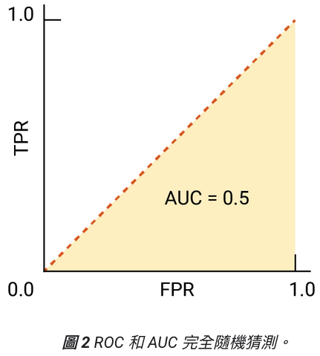
ROC Curve (bad case)
(Useful!!) https://developers.google.com/machine-learning/crash-course/classification/roc-and-auc?hl=zh-tw
假設我們用模型對10個人做COVID-19檢測：
(healthy 代表 negative; COVID-19 代表 positive)
healthy
COVID-19
💪
🦠
🦠
💪
💪
🦠
💪
🦠
🦠
💪
0
20
40
60
80
100

Slide 30
完美模型的條件
分類結果完全正確
沒有誤判
No False Negatives: TPR 越高越好
No False Positives: FPR 越低越好
完美模型中存在一個「理想 threshold 區間」，使我們能同時得到 TPR = 1 且 FPR = 0

Slide 31
Confusion Matrix (混淆矩陣) for ROC
 | Actually positive | Actually negative
Predicted positive | True positive (TP) | False positive (FP)
Predicted negative | False negative (FN) | True negative (TN)
TP / (TP + FN): True Positive Rate (TPR)
又稱作 Recall
FP / (FP+TN): False Positive Rate (FPR)

Slide 32
Confusion Matrix for General Uses
 | Actually positive | Actually negative
Predicted positive | True positive (TP) | False positive (FP)
Predicted negative | False negative (FN) | True negative (TN)
斜對角數值越大越好
TP 和 TN 越大越好
Precision = TP / (TP + FP)
模型預測的TP比例
Recall = TP / (TP + FN)
True Positive Rate (TPR)
F1-score (廣義) = 2(Precision*Recall) / (Precision+Recall)

Slide 33
roc_curve using scikit-learn
https://scikit-learn.org/stable/modules/generated/sklearn.metrics.roc_curve.html
import numpy as np from sklearn import metrics y = np.array([1, 1, 2, 2]) scores = np.array([0.1, 0.4, 0.35, 0.8]) fpr, tpr, thresholds = metrics.roc_curve(y, scores, pos_label=2)

Slide 34
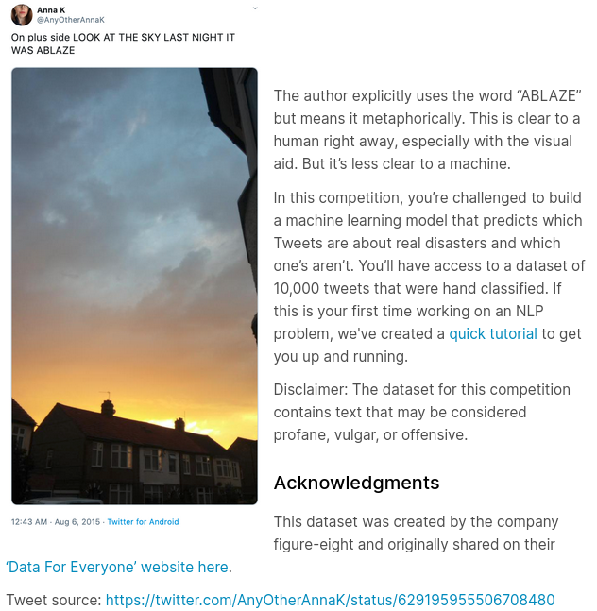
Natural Language Processing with Disaster Tweets
You are predicting whether a given tweet is about a real disaster or not. If so, predict a 1.
If not, predict a 0.
資料範例 ➡️ (但任務中只需要進行文字分類)

Slide 35
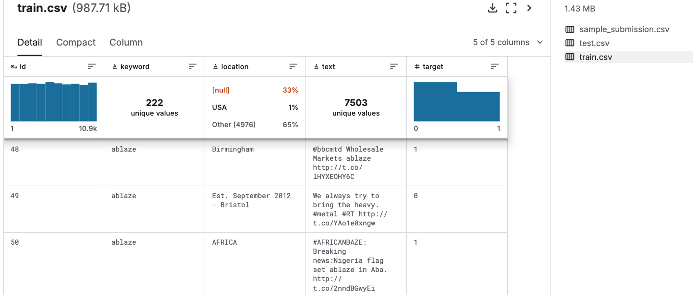
Natural Language Processing with Disaster Tweets
Data structure and example

Slide 36
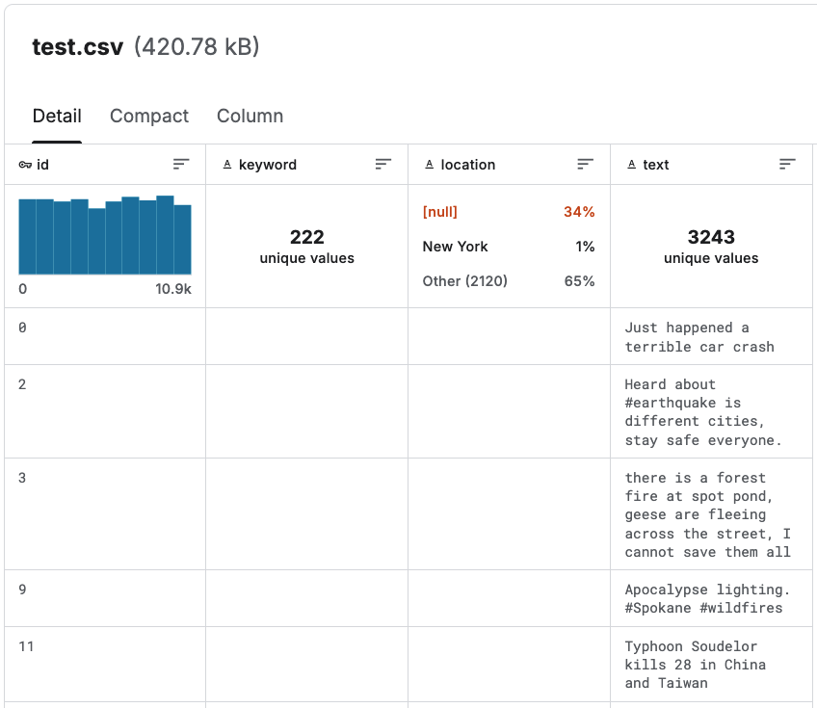
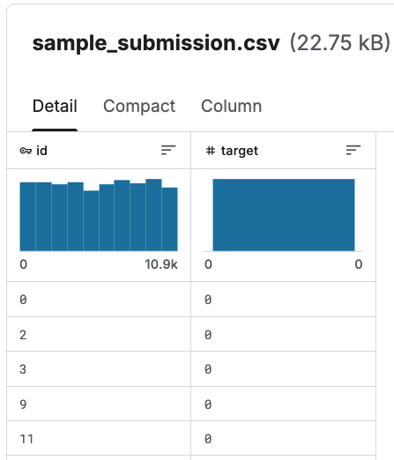
Natural Language Processing with Disaster Tweets
How to submit?

Slide 37
Natural Language Processing with Disaster Tweets
分數計算? 採用 F1-score
 | Actually positive | Actually negative
Predicted positive | True positive (TP) | False positive (FP)
Predicted negative | False negative (FN) | True negative (TN)
Precision = TP / (TP + FP)
模型預測的TP比例
Recall = TP / (TP + FN)
True Positive Rate (TPR)
F1-score (廣義) = 2(Precision*Recall) / (Precision+Recall)

Slide 38
Candidates
Google Open Images Object Detection RVC 2020 edition
https://www.kaggle.com/competitions/open-images-object-detection-rvc-2020
NBME - Score Clinical Patient Notes (Code competition)
https://www.kaggle.com/competitions/nbme-score-clinical-patient-notes/overview
Google QUEST Q&A Labeling (Notebook competition)
https://www.kaggle.com/competitions/google-quest-challenge

Slide 39
Project checkpoints (暫定)
Week 9: 確定各組的題目
Week 11: 進度報告 PPT (5 pages)
Week 13: 進度報告 PPT (5+5 pages), Presentations (selected teams)
Week 15 – Week 16: Final presentations for all teams (maybe poster)
Week 16 結束前: 繳交書面報告以及程式碼

Slide 40
期末 Project 規定 (暫定)
需要上傳 Kaggle Leaderboard
這些任務都僅需要上傳 predictions 到 Kaggle 即可
每次報告都需要列出每位組員的貢獻內容，以及組員間的工作比重 (%)

Slide 41
Thank you!
Instructor: 林英嘉
✉️ yjlin@cgu.edu.tw
TA: 林君襄
✉️ becky890926@gmail.com

